Slide 1
Delivery Box
AI Object Recognition Program
IT Education Center

Slide 2
01
02
03
Introduction
production process
Results, Conclusions
Need for research
Programs to used
Programming procedures
Expected Commercialization Results
The source of information

Slide 3
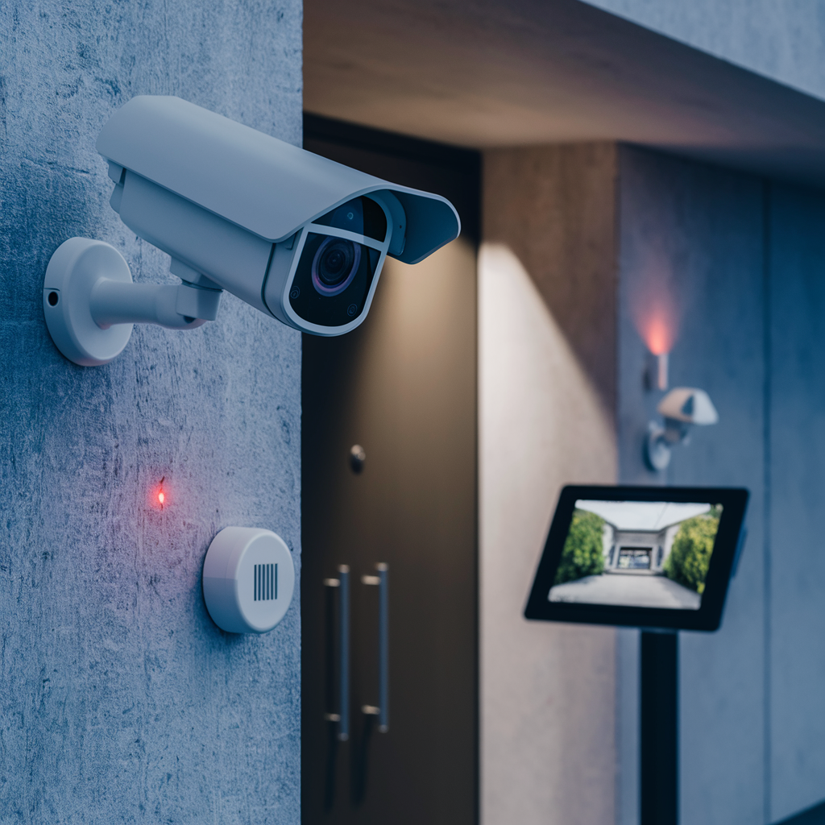
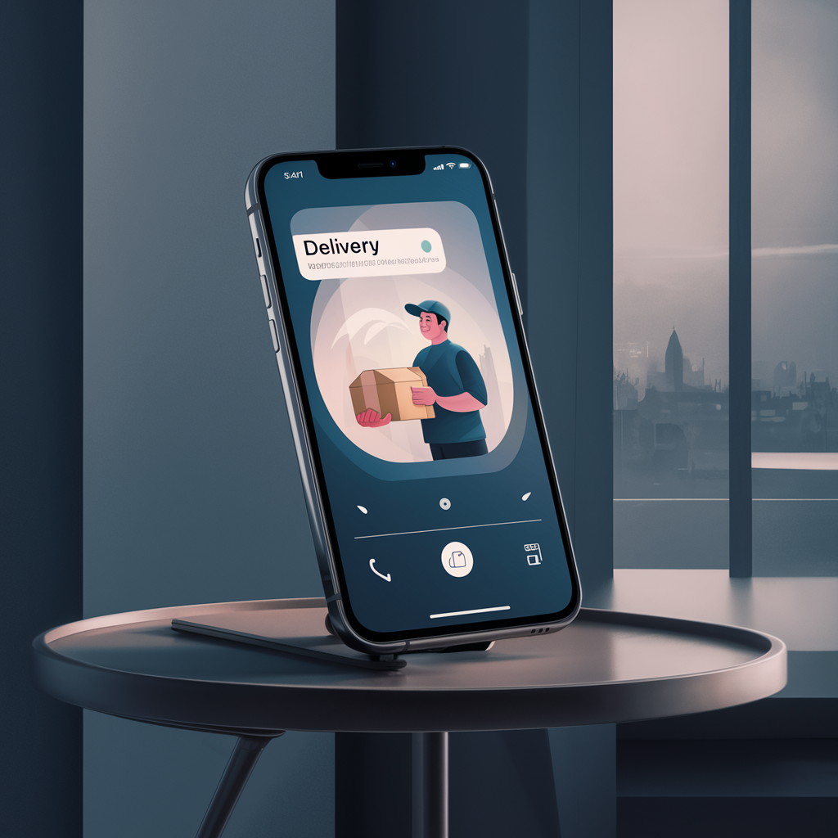
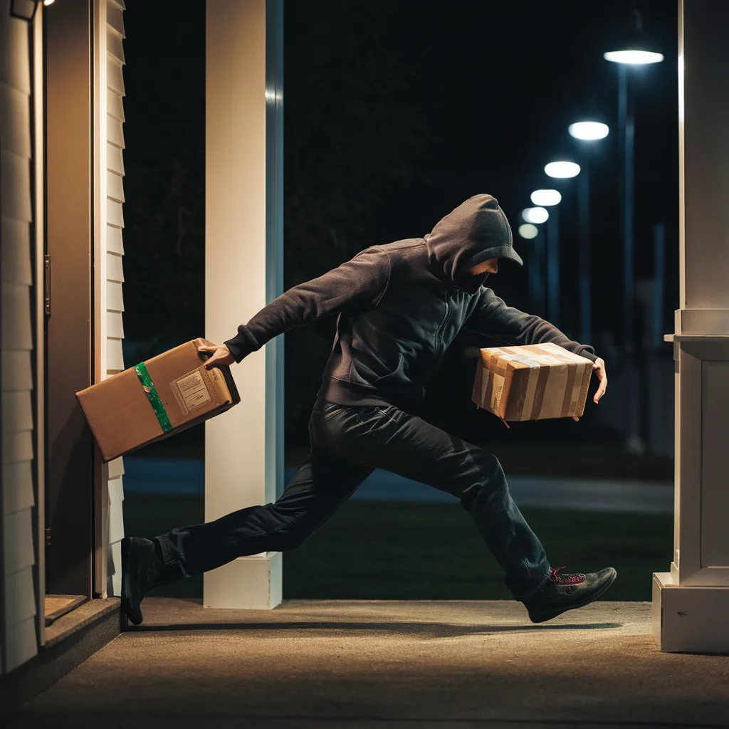
Need for research
Apartment
-Real-time check in front of private entrance of apartment -If the package is recognized, a mobile phone alarm is sent
-If stolen, check the time zone and the description of the thief

Slide 4

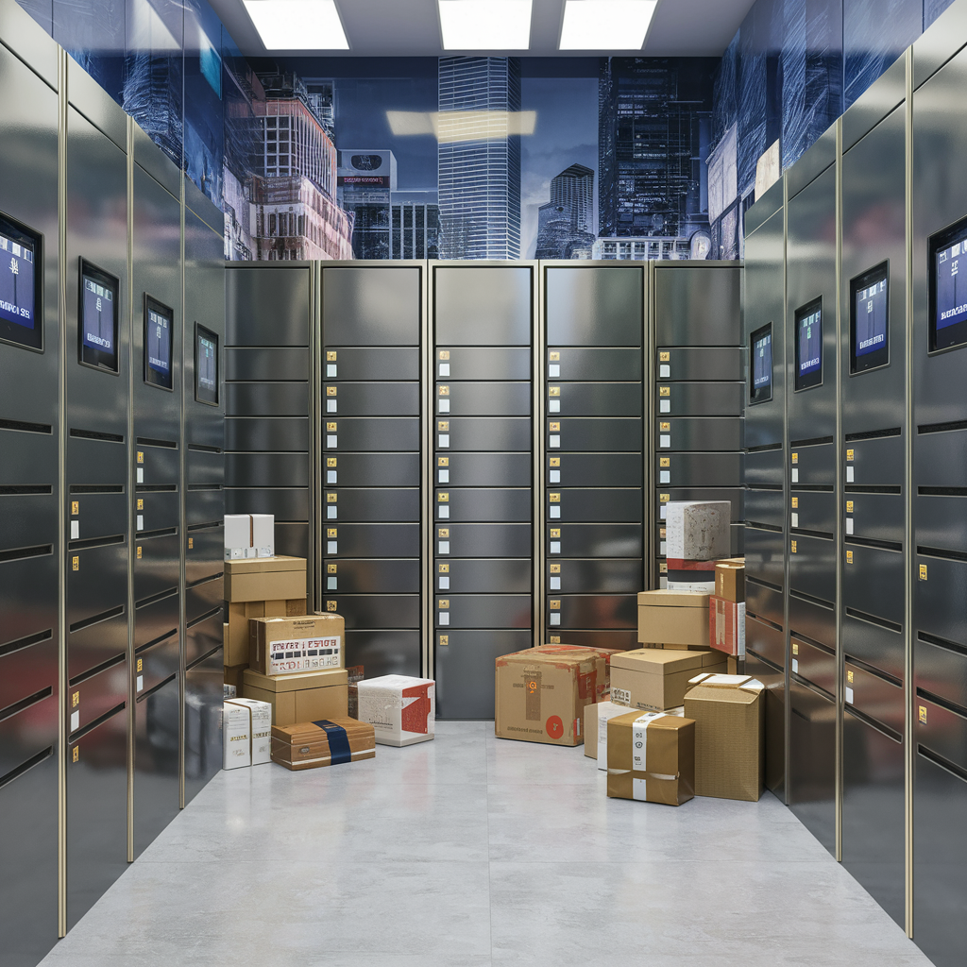

Need for research
Joint Courier Storage Box
Send mobile phone alarms to each owner when the package is recognized
In order to prevent loss or change in places with separate storage areas such as dormitories and small apartments

Slide 5

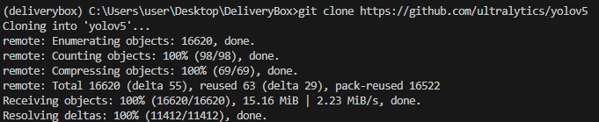
Production process
1. Create a virtual environment in python
2. Replicates yolov5's learning function Ai
process to a virtual environment

Slide 6

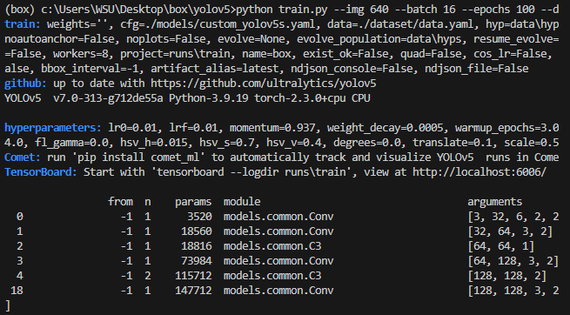
Production process
3. Learn the prepared dataset from yolov5 4. Run to check results

Slide 7
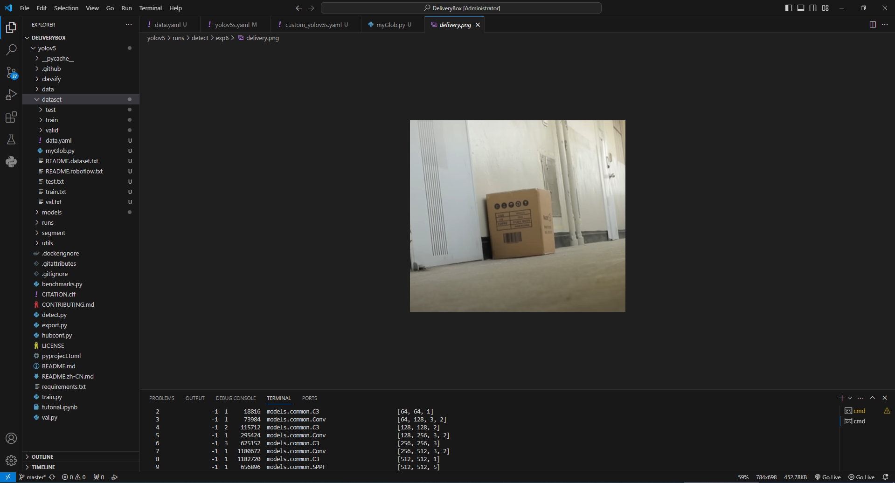
Box 0.92%
Result output
Python screen

Slide 8
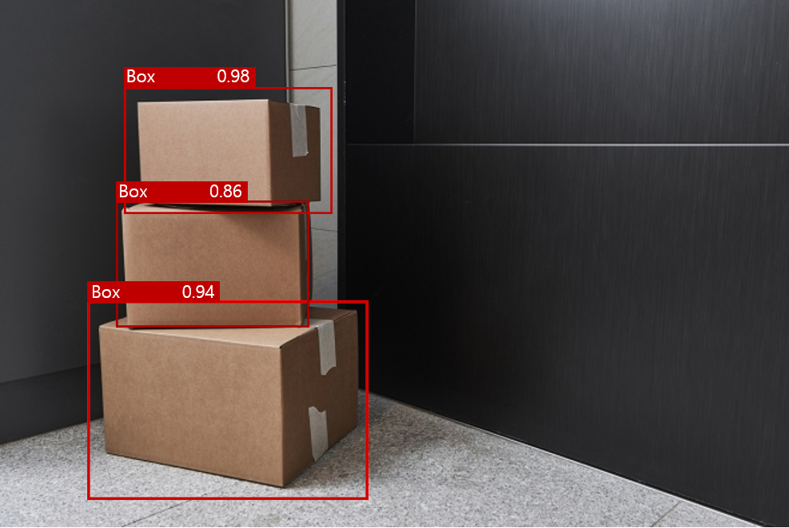
Box 0.92%
Result output
Python screen

Slide 9
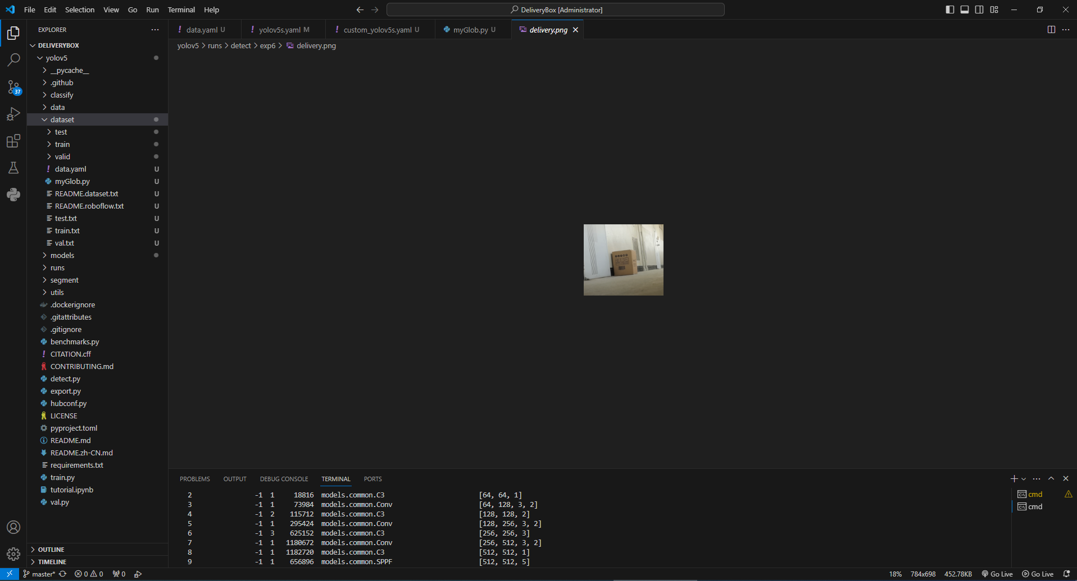
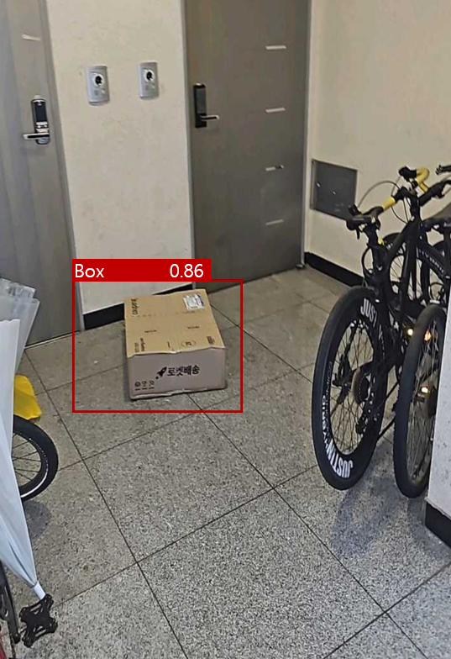
Result output
Python screen

Slide 10
Conclusions
Expected Commercialization Results
It can be produced for notification and record keeping through camera and application interworking

Slide 11

The source of information
DataSet
Yolov5
https://universe.roboflow.com/parcel-cbbbq/parcelbox/dataset/9
https://github.com/ultralytics/yolov5

Slide 12
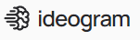
The source of information
Python
Picture
https://www.python.org
https://ideogram.ai

